Slide 1

Fantastic Bugs and Where to Find Them
Jaeyoon Kim, Aniruddh Agarwal, Chandler Meyers, Grant Reszczyk, Jinsoo Ihm, Sharon Ye

Slide 2
Design Goals
Maximize the size of our index
Deliver high quality results
Finish the project
Notes:
Done by 2 mins

Slide 3

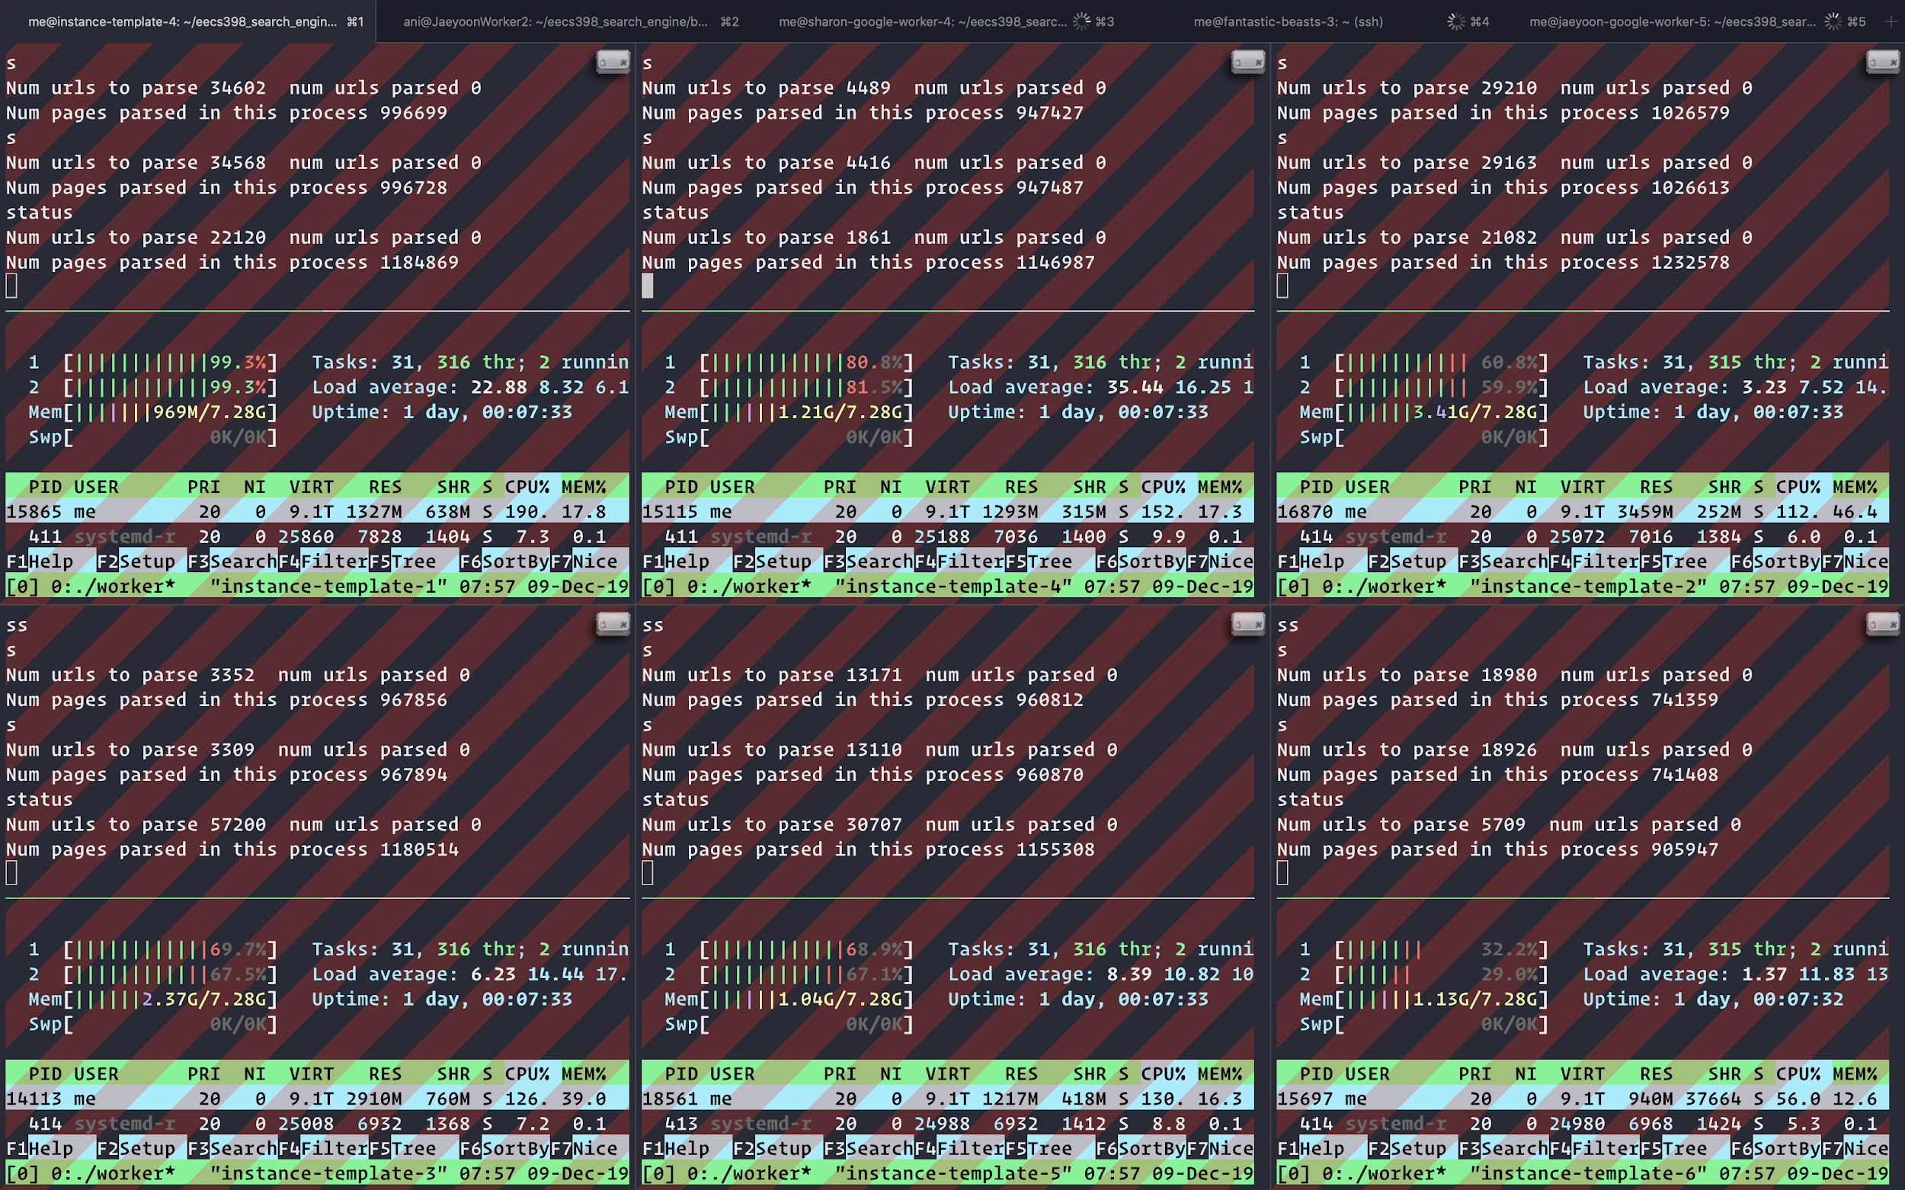
Distributed Crawling
Number of machines: | 26
Number of threads: | 7500

Slide 4
We’ve crawled
761,228,298 pages
over roughly 4 days of compute time

Slide 5
Numbers
Pages crawled: | 761,228,298
Seen URLs: | roughly 5.2 billion
Peak rate: | 12 million / hour
Average rate: | 8 million / hour
Notes:
Done by 4 mins

Slide 6
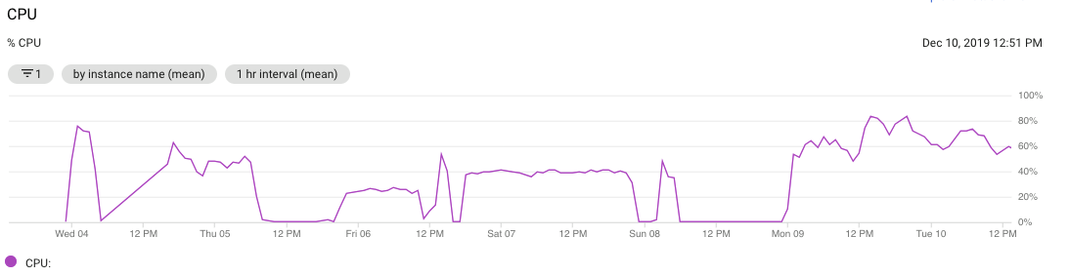
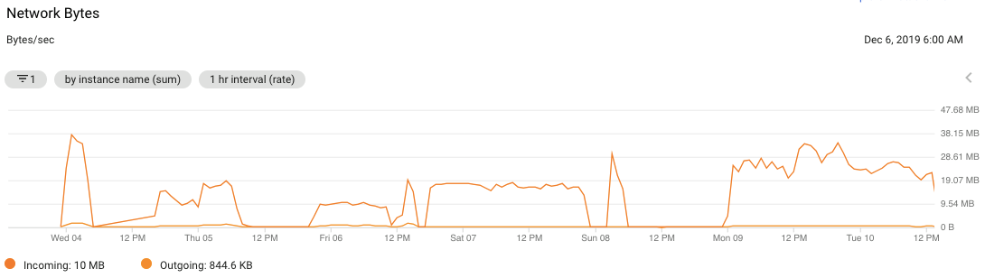

Slide 7
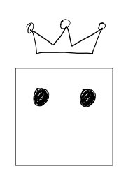
Master Computer
A single computer but multi-threaded
Maintains the frontier
Maintains all unique urls we have seen
Crash safe and able to shutdown

Slide 8
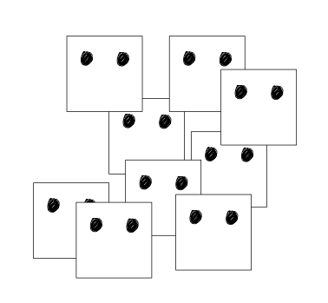
Worker Computers
Barrier from the surface area of the system
Multiple machines
Each worker is multi-threaded
Constantly downloading HTML pages
Parses and stores pages

Slide 9
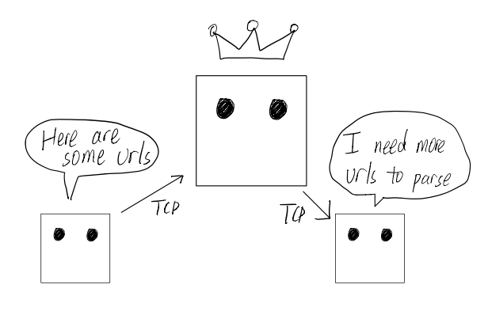
Communication
Master does not know anything about workers
Each worker is given the address of master
When worker is low on urls to parse, worker requests more urls from master
When worker parsed 1000 pages, it sends back all the urls found to the master

Slide 10
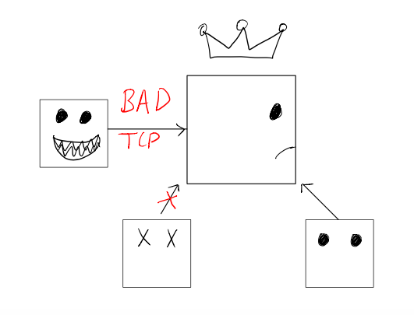
Advantage 1: Robustness
The workers contains all the “surface area”
If they crash, master is unaffected
If master receives a broken message, master can just ignore it

Slide 11
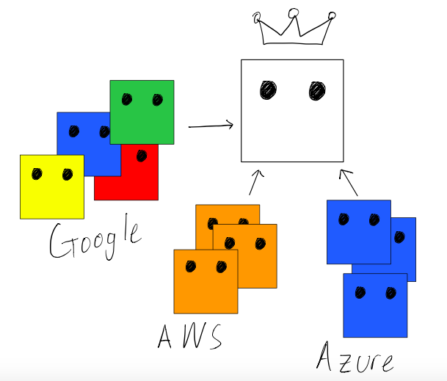
Advantage 2: Dynamic
Workers can spawn / shutdown at any time
This is a major advantage since we can use any cloud services
More money!
If we run out of funds in one account, just move to another one!

Slide 12
Details
Frontier
Adder
Thread
We need to handle many workers!
To increase concurrency, data structures are “divided”
Frontier Bin
Bloom Filter
Adder
Thread
Frontier Bin
Bloom Filter
Adder
Thread
Frontier Bin
Bloom Filter

Slide 13
Frontier
Adder
Thread
Frontier Bin
Bloom Filter
URLs from some worker
Adder
Thread
Frontier Bin
Bloom Filter
Adder
Thread
Frontier Bin
Bloom Filter

Slide 14
Frontier
Adder
Thread
Frontier Bin
Bloom Filter
Atomic
Cursor
URLs
Adder
Thread
Frontier Bin
Bloom Filter
Adder
Thread
Frontier Bin
Bloom Filter

Slide 15
Details
Frontier
Adder
Thread
When worker requests more urls, a thread will spawn
A thread will choose a frontier bin to get urls from
Couple of urls are chosen at random in order to 75 percentile ranking
4000 random are chosen, and urls beyond 75 percentile are sent to worker
Frontier Bin
Bloom Filter
Adder
Thread
Frontier Bin
Bloom Filter
Adder
Thread
Frontier Bin
Bloom Filter
Notes:
Done by 7:30 mins

Slide 16
Parser
Simple text based
Keep flags such as title, header, emphasized
<![CDATA[ SOME CRAZY JAVASCRIPT ]]>
Never crashed while parsing more than 700 mil

Slide 17
Downloader
Some websites need SNI above SSL
Redirect between http and https
Notes:
Done by 9 mins

Slide 18
Problems

Slide 19

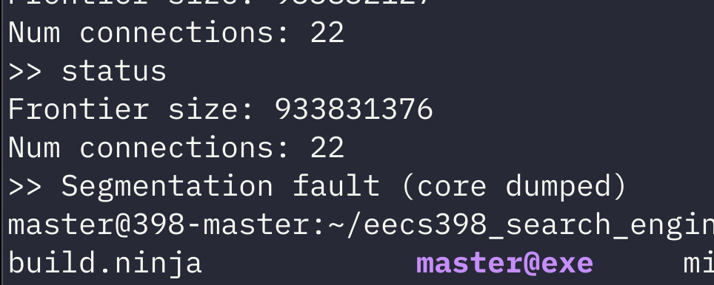
Problems
Master computer is a single point of failure. If the master crashes for any reason, all the workers will eventually stop crawling.
On the plus side: on-disk data structures are crash-safe, and the crawler can be restarted easily.

Slide 20
Problems
Difficult to scale with one master as the number of workers and their efficiency increases
Disk accesses and network bandwidth too much of a bottleneck on one master; had to stop storing anchor text and adjacency lists to keep crawling at a reasonable speed

Slide 21
Problems
Did not implement rigorous robots.txt handling initially
Faced the consequences...

Slide 22
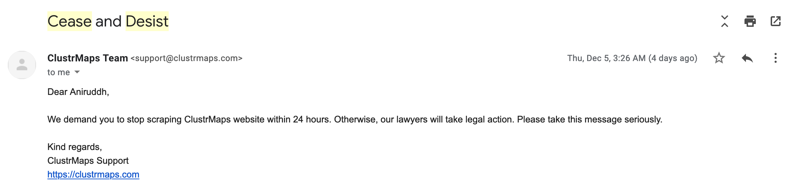

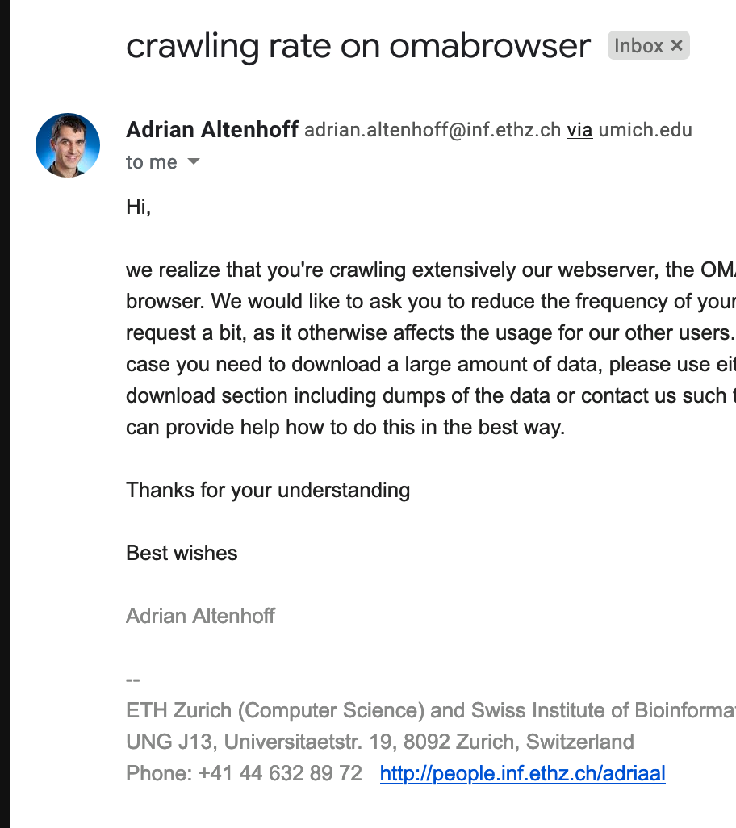
“With great speed, comes great impoliteness”
Notes:
Done by 11 mins

Slide 23
Index Structure
Page Store
All words in a document in order
Facilitates snippets as well as ranking
Inverted Word List Chunks
Contains posting lists for all words
Facilitates fast ranking and searching
Notes:
Having this divided structure allowed us to start crawling faster as the Inverted Word List was more work to implement. The crawler would output Page Store files and the IWL Chunks were built using the Page Store file.

Slide 24
Index Stream Readers
Word, Document, Empty Word
AND, OR
Phrase, Container
Notes:
Done by 12:30 mins

Slide 25
Ranking & Snippets
Page Rank did not happen :(
Fast Heuristics (length of URL, TLD, etc.)
Term Frequency Inverse Document Frequency (TFIDF)
Snippet Rank - inspired by HW1 Most Positive Subarray

Slide 26
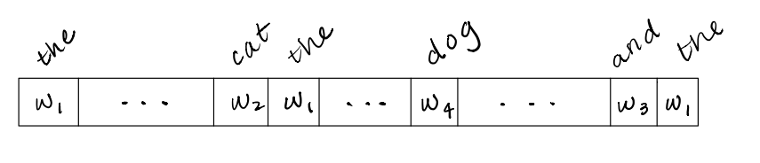
Query: “the cat and dog”
Let w₁,...,w₄ be weights proportional to the TFIDF of each string in the query.
Problem: find the “most positive subarray” with a fixed window size. This roughly corresponds to the biggest “cluster” of the most important words in our query.
Notes:
Done by 13:30 mins

Slide 27
Notable Library Design Choices
UniquePtr
No memory leaks*
“Nobody is allowed to type the word new!” - A very emphatic Ani, 2019
*Except for a fantastic bug in UniquePtr that caused us to leak almost all of our allocated memory initially

Slide 28
Notable Library Design Choices
StringView
A StringView is a pointer and a length, and can refer to strings in both memory-mapped files and allocated on the heap.
Helps avoid duplicating strings in memory, and presents a std::string-like interface for C-strings.
“Always prefer StringView.” - The very wise Ani, 2019*
*Ani totally didn’t edit this slide at the last minute

Slide 29
Notable Library Design Choices
DiskVec
Represents an array in a memory-mapped file. Uses the “cursor” pattern to allow concurrent access.
Can be used creatively to store non-homogeneous data (PageStore)
Example uses: UrlStore (array of seen URLs), Frontier (array of offsets into UrlStore), and PageStore (raw page info generated by the parser containing information needed to index the page)
Notes:
Done by 14:30 mins

Slide 30
Server Component
Used library from previous project
Added multi-threading and ability to serve static images.
Has a basic html templating system
HTML + Bootstrap + Javascript for frontend

Slide 31
Things we are working on
Distribute master to remove bottlenecks in crawling
Divert more resources towards building the index
Distribute querying
Merge index chunks in such a way to optimize search times
Notes:
Done by 15 mins

Slide 32
Questions?

